Slide 1
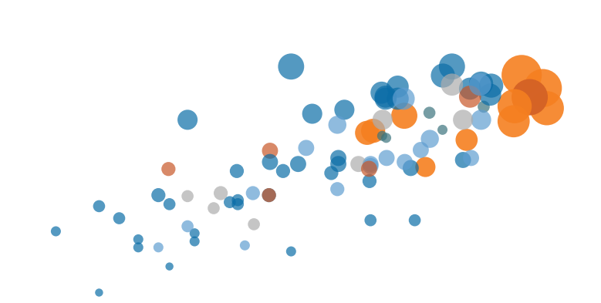
Data Visualization
Tableau with R

Slide 2


Introduction to Tableau and R Integration
What are the benefits of using Tableau and R integration?
  Access R packages or functions for quantitative analysis
  Take advantages of Tableau's data visualization capacities

Slide 3
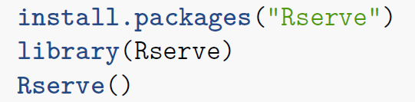

Introduction to Tableau and R Integration
How is Tableau integrating with R?
  Install Rserve Package
Tableau → Help → manageR Connection → Give 127.0.0.1 and Port.No:6311 and testconnection → it will gives success connection
  Create Calculation Field in Tableau
  Use one of the four functions:
  SCRIPT_BOOL: Return a Boolean
  SCRIPT_INT: Return an Integer
  SCRIPT_REAL: Return a Real
  SCRIPT_STR: Return a String
Input Data
Pass R Script and Data into R
Rserve
Output Data
Interactive Data Visualization

Slide 4
Introduction to Tableau and R Integration
How Tableau sends Data to R:
  Uses SCRIPT_*() → work as a table calculation. It requires aggregate functions.
  If the data is not in aggregate manner → wrap it up.

Slide 5
Introduction to Tableau and R Integration
Example – 1:
Simple Connection example:
  Create a Calculation field and type following in expression box
  SCRIPT_STR('hello <- “IIIT Allahabad"',ATTR([Sales]))
  Check the Result
Simple k-means Clustering
  SCRIPT_INT('set.seed(42);result <- kmeans(data.frame(.arg1,.arg2,.arg3,.arg4), 3);result$cluster;', SUM([F1]), SUM([F2]),SUM([F3]),SUM([F4]))

Slide 6


THANK YOU

